Slide 1
Chapter 2: Group development
Hoang duc huy, ma.
SSG103 – Summer semester 2021

Slide 2
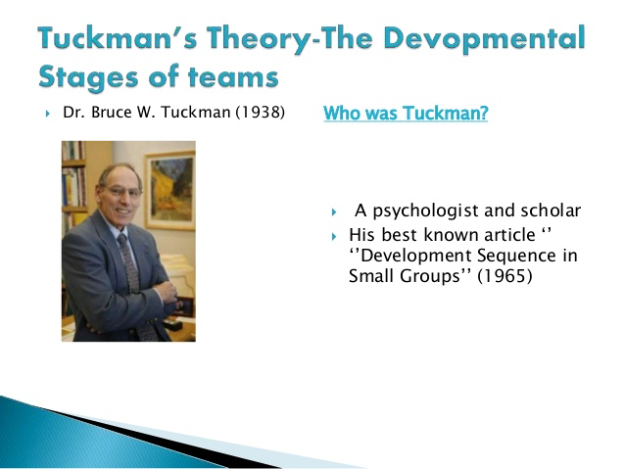

Slide 3
Jack’s story: Questions
What are problems of Jack’s group? Name them.
What are main stages in the development of a group?
What is advice for Jack in the first stage?
What are Seven Golden Rules?
https://www.youtube.com/watch?v=2QbXc6E08H4&t=4s

Slide 4
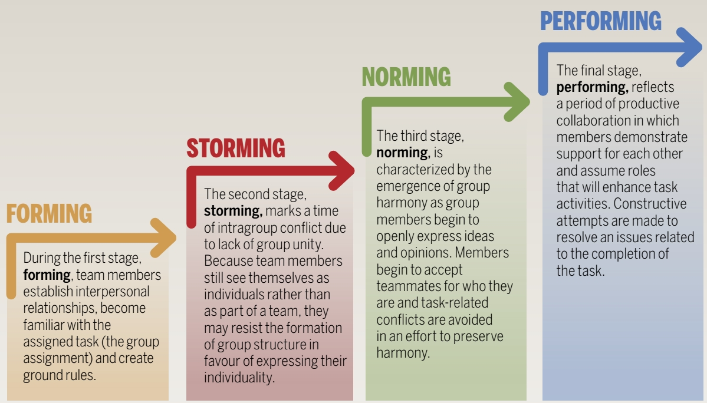
TUCKMAN’S LADDER OF GROUP DEVELOPMENT

Slide 5
Group Development Stages
Forming = create based on common goal
Storming = difficult in WIG/culture shock
Norming = solve problem
Performing = act to reach goal
Adjourning = mission completed => delete group

Slide 6
Match the Group Development Stages QUIZ
Stage 1: Forming
Stage 2: Storming
Stage 3: Norming
Stage 4: Performing
Stage 5: Adjourning
__ Members focus energy on achieving group goals
__ Members compete for status
__ Members become acquainted/familiar and consider their task
__ Members resolve conflicts and develop “rules of engagement”
__ Members achieve the group’s goal and may begin to disband

Slide 7
Match the Group Development Stages QUIZ
Stage 1: Forming
Stage 2: Storming
Stage 3: Norming
Stage 4: Performing
Stage 5: Adjourning
_4_ Members focus energy on achieving group goals
_2_ Members compete for status
_1_ Members become acquainted/familiar and consider their task
_3_ Members resolve conflicts and develop “rules of engagement”
_5_ Members achieve the group’s goal and may begin to disband

Slide 8
Forming Stage
Challenge: Balancing Individual and Group Goals-HIDDEN GOAL
Members are socially cautious and polite.
Members learn about their tasks and test personal relationships.

Slide 9
Primary Tension
The social unease that accompanies the getting-acquainted process in groups

Slide 10
Resolving Primary Tension
Be positive and energetic.
Be patient and open-minded.
Be prepared and informed.

Slide 11
Storming Stage
Challenge: Balancing Conflict and Cohesion
Members compete for status and roles.
Members openly disagree on issues.
Groups experience Secondary Tension.

Slide 12
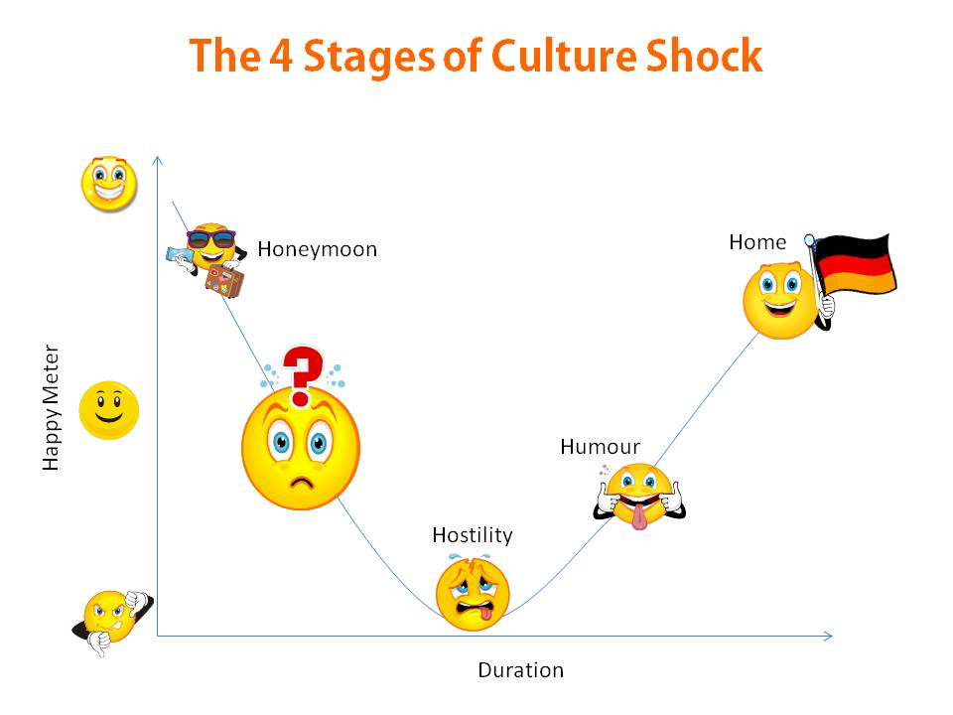

Slide 13
Secondary Tension
The frustration and personality conflicts experienced by group members as they compete for acceptance and achievement

Slide 14
Norming Stage give in + give up
Challenge: Balancing Conformity and Nonconformity
Groups resolve primary and secondary tensions.
Groups develop norms or ground rules.

Slide 15
Performing Stage give job to suitable person
Challenge: Balancing Task and Maintenance Dimensions
Group focuses on productivity and member satisfaction.
Groups adapt and change if necessary.

Slide 16
Adjourning Stage
Challenge: Balancing Engagement and Disengagement
Upon completing the group task:
The group may disband.
Members may leave the group for personal or professional reasons.
Some members may take on a new group task.

Slide 17
Socializing Newcomers
Describe each phase of the group socialization process:
Antecedent: ___________________________
Anticipatory: __________________________
Encounter: ____________________________
Assimilation: __________________________
Exit: _________________________________

Slide 18
Group Goal Setting: p. 37
(Criteria) Effective group goals are:
Specific (very detail): yes
challenging but realistic :
accepted by group members.
used to evaluate performance:
linked to feedback:
allow for member growth = motivation (physical, mental, personal, social…....):

Slide 19
Set your goals
Clarity. Is the goal clear, specific, and observable if achieved?
Challenge. Is the goal challenging, inspiring, and thought-provoking?
Commitment. Do members see the goal as meaningful, realistic, and attainable?
Compatibility. Can both group and individual goals be achieved?
Cooperation. Does the goal require member cooperation?
Cost. Does the group have adequate resources (time, money, materials) to achieve the goal?

Slide 20
Hidden Agendas
Members’ private goals conflict with the group’s goals

Slide 21
hidden agenda
I want a boyfriend
- talk
Share
Eat out together
Good looking
Smell good
Study well
Do homework for you
I want a husband
Job
Good income
Cook well
Healthy
Smell good, clean
Work well
Do housework

Slide 22
Goal = get a good job ?
To find a good job, nice salary, >1000usd take home income,
8hours/day, 5 days/week
Satisfy => what you do

Slide 23
Questions for Resolving Hidden Agendas
What is the group’s common goal?
Does the leader have any personal concerns or goals that differ from member or group goals?
Do any members have any personal concerns or goals that differ?

Slide 24
Types of Norms
Explicit Norms: rules Put in writing or stated verbally; easy to recognize
Example: ________________________________
Implicit Norms: Rarely discussed or openly communicated; not as easy to recognize
Example: what to wear to school ________________________________

Slide 25
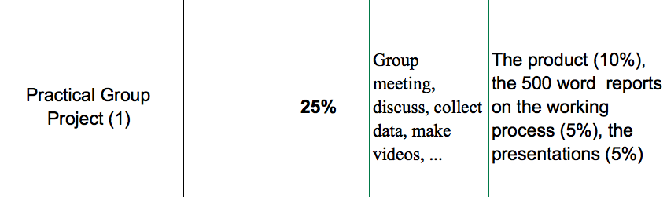
Achievement Norms
Implicit
Explicit

Slide 26
Types of Norms p.39
Example:_________
Example _________
Example _________
Example _________
Interaction Norms
Procedural Norms: how the group work
Status Norms
Achievement Norms

Slide 27
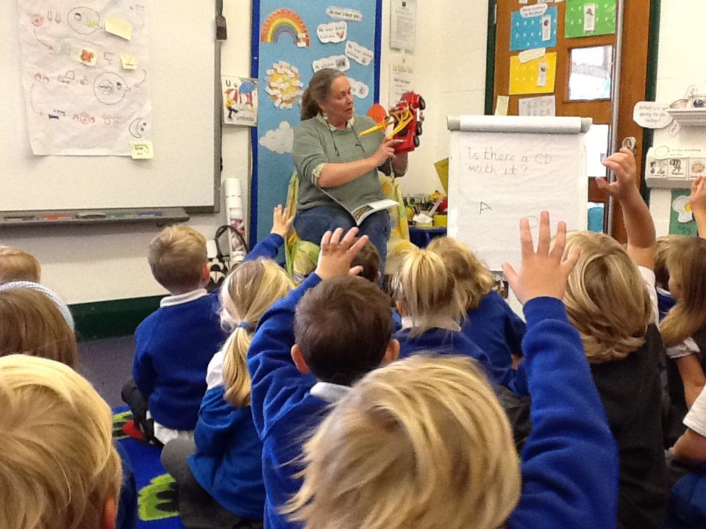


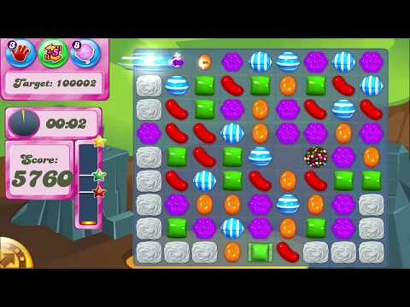

Which one support class goal?

Slide 28
Support group GOAL
Conformity
Nonconformity

Slide 29


Slide 30
Support group GOAL
Destructive Nonconformity

Slide 31
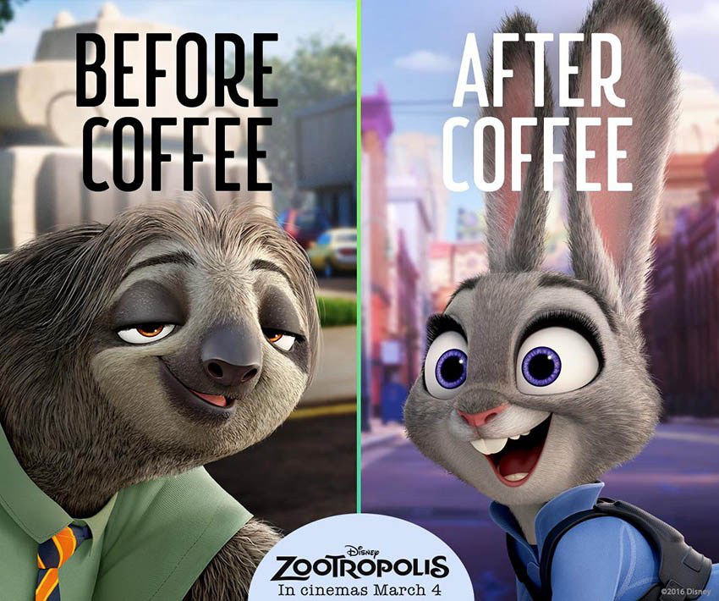
Should we keep the rule?

Slide 32
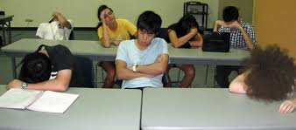

Support group GOAL
Constructive Nonconformity

Slide 33

Constructive Nonconformity
Destructive Nonconformity

Slide 34

Harry Porter

Slide 35
Conformity ↔ Nonconformity
Conformity
Choosing a course of action that group members favor and that is socially acceptable
Nonconformity
Choosing a course of action that does not meet the expectations of the group

Slide 36
Types of Nonconformity
Constructive nonconformity (to build)
Violating a norm while still supporting the group and its goal
Destructive nonconformity (to kill)
Violating a norm that negatively impacts the group and its goal
Responses to destructive nonconformity:
Accept
Confront
Exclude

Slide 37
Group discussion
Group tasks
Member tasks
Group 1-: Find 3 conformity norms for FPT students
Group 2-: Find 3 destructive nonconformity for FPT students
Group 3-: Find 3 constructive nonconformity for FPT students
Group 4-: Find 3 constructive nonconformity for FPT lecturers
Group 5 - Find 3 conformity norms for FPT lecturers
A: make sure everyone give opinion about the given topic
B: make sure everyone speak English
C: take note
D: report on board
E: enjoy

Slide 38
Group discussion – 20’
Group tasks
Member tasks
Group 1 Find 3 conformity norms for your class
Group 2 Find 3 destructive nonconformity for your class
Group 3-Find 3 constructive nonconformity for your class
A: make sure everyone give opinion about the given topic
B: make sure everyone speak English
C: summarize and write the group’s opinion
D: report to class

Slide 39
Strategies for Changing Norms
Fill in the Blanks: Identify ways to change group norms
Through suggestions or actions of high-status members or a leader
__________________________________
__________________________________
__________________________________

Slide 40
Match Group Stages and Dialectics
Which dialectic(s)
operate during:
A. Forming
B. Storming
C. Norming
D. Performing
E. Adjourning
__A_ Individual ↔ Group Goals
__B_ Conflict ↔ Cohesion
__C_ Conforming ↔ Nonconforming
__D_ Task ↔ Social Dimensions
__B_ Homogeneous=EVERYONE AGREE WITH EACH OTHER, WHOLE GROUP HAS SAME IDEA ↔ Heterogeneous
__S, D_ Leadership ↔ Followership
_N__ Structure ↔ Spontaneity
_P__ Engaged ↔ Disengaged
_NORM__ Open SYSTEM = GROUP MEMBER + OUTSIDE MEMBER WORK ↔ Closed System= ONLY GROUP MEMBER WORK TOGETHER

Slide 41
Characteristics of Effective Groups
A clear, elevated goal
Results-driven structure
Competent team members
Unified commitment
Collaborative climate
Standards of excellence
External support and recognition
Principled leadership
Larson and LaFasto, TeamWork

